Slide 1

Predicting Employee Attrition
Group 7b: Amanda Carducci, Emi Erekosima, Andrew Ghali, George Khramtchenko
Notes:
Speaker: Amanda Carducci

Slide 2
Agenda
Introduction
Exploration of Data
Modeling Approach
Relevant Business Findings
Recommendations
References
Notes:
Speaker: Amanda Carducci

Slide 3
Introduction
Dataset chosen: IBM HR Analytics Employee Attrition dataset from Kaggle.
Includes demographic, compensation, job satisfaction, and performance information.
Prediction Target: Attrition (Yes/No)
  Binary indicator of whether an employee left the company.
Business Problem: Employee turnover is costly: recruiting, onboarding, and training expenses.
  Goal: Predicting attrition to help reduce turnover costs and identify high risk employees.

Slide 4
Dataset Overview
1,470 employees 35 features
Mixed demographics, compensation, performance, and satisfaction data
Target: Attrition (Yes/No)
Early signals: Overtime, Income, Tenure, Satisfaction
Notes:
This dataset includes 1,470 employees with 35 different variables covering demographics, job characteristics, compensation, performance, and multiple satisfaction metrics.
Our target variable is Attrition, coded as a simple Yes or No.
During early exploration, several variables consistently showed separation between employees who stayed in those who left especially Overtime, Monthly Income, Years at Company, and the various satisfaction measures.
These early indicators guided our feature engineering and helped us anticipate which predictors would later become important in the models.

Slide 5
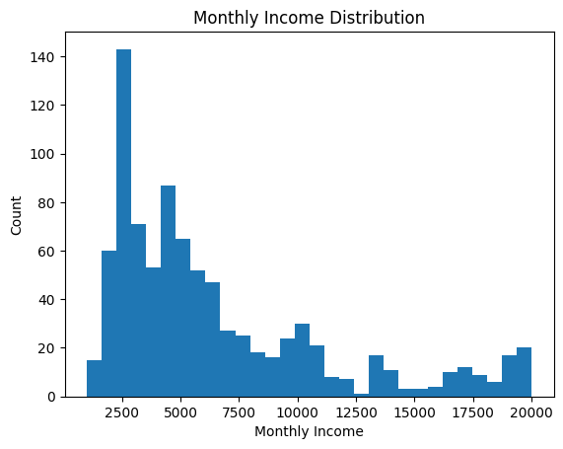
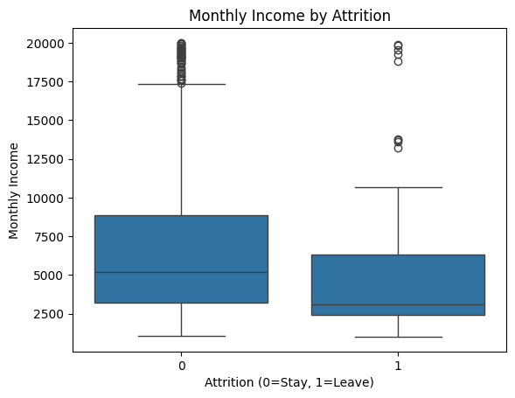
Exploration of Data

Slide 6
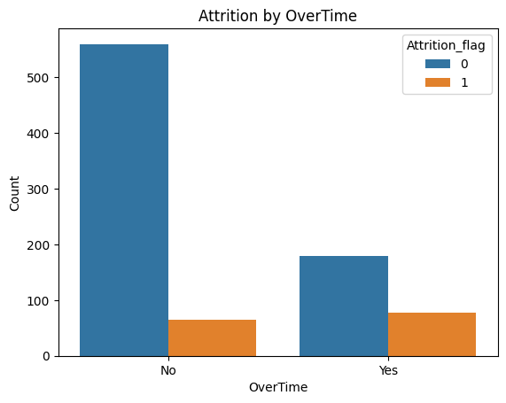
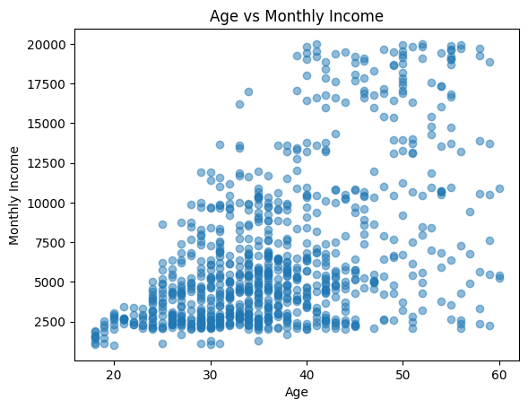
Exploration of Data

Slide 7
Modeling Approach
Models tested include:
  Logistic Regression
  Decision Tree
  Random Forest
  Gradient Boosting
The best model was the Bootstrap Forest- Test Performance

Slide 8
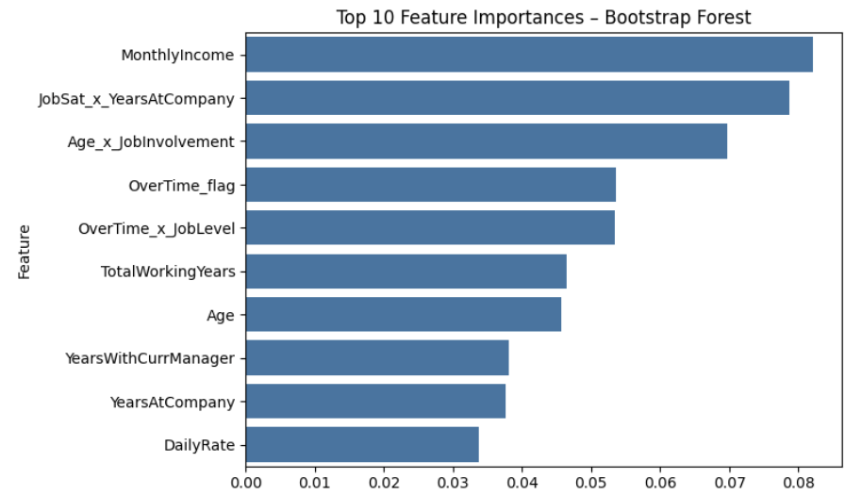
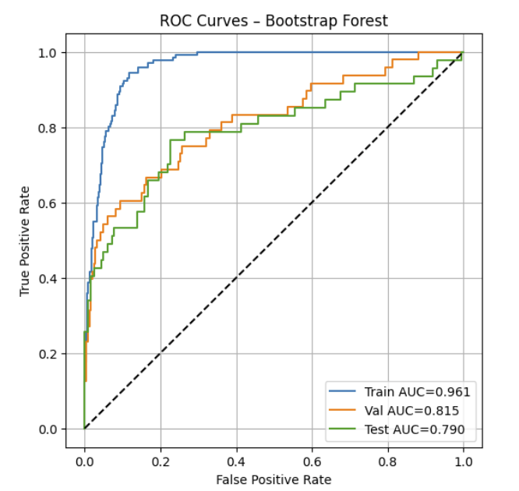
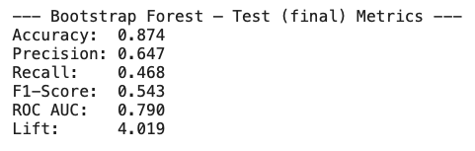
Bootstrap Forest
Notes:
Our best performing model is the Bootstrap Forest.
You can see the ROC curves on the left. The model performs very strongly on the training set, and while there is some expected drop off on validation and testing, it still maintains solid generalization with a test AUC of about 0.79.
On the right, we have the top ten most important predictors. The strongest drivers include Monthly Income, Job Satisfaction combined with Years at Company, Age combined with Job Involvement, and Overtime, which all align with the patterns we saw during our exploratory analysis.
At the bottom are the final test metrics. The model reaches about 0.87 accuracy, with meaningful precision and a lift of just over 4, meaning it’s four times better than random at identifying high-risk employees.
Overall, this model gave us the most stable and interpretable performance, which is why we selected it as our final model for predicting attrition.

Slide 9
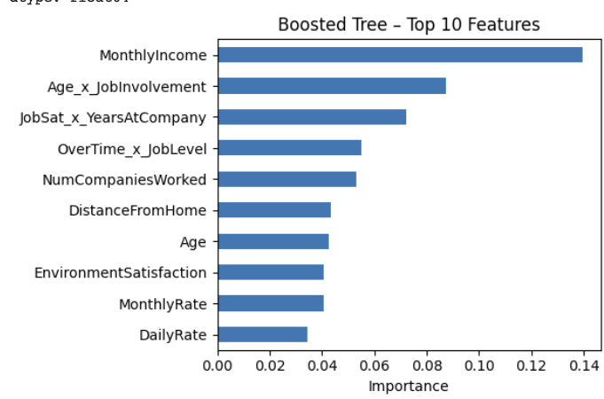
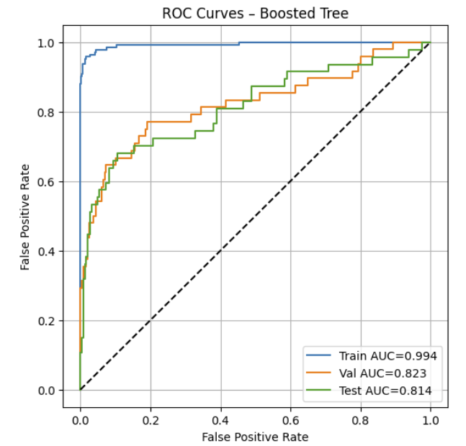
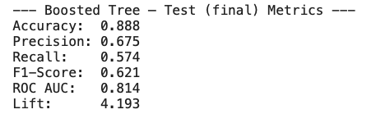
Boosted Tree
Notes:
Next is our Gradient Boosting model. Boosting performed very strongly and was the closest competitor to the Random Forest.
On the left, you can see the ROC curves. The training AUC is extremely high… almost perfect, which is a strong indicator of overfitting. On validation and test, performance drops to a test AUC of about 0.81, which is still good.
On the right are the top predictors. Boosting places the highest importance on Monthly Income, the interaction between Age and Job Involvement, and Job Satisfaction paired with Years at Company.
At the bottom are the test metrics, showing about 0.89 accuracy, higher recall, and a lift of 4.19.
Even with its strong accuracy, we did not select this as the final model because the overfitting was persistent.
We tried tuning the learning rate, estimator count, and depth, but with a small and imbalanced dataset, boosting memorizes noise.
The only real fix would be a much larger dataset, so the Random Forest provided more stable generalization and became our primary model.

Slide 10
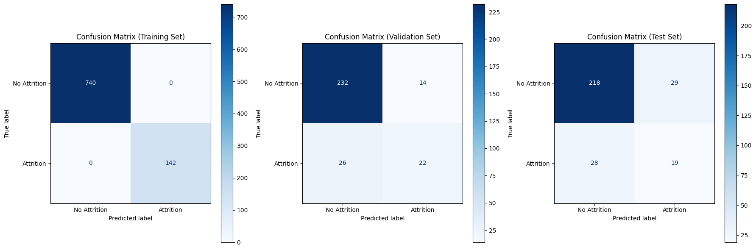
Neural Network
This behavior indicates that the Neural Network, given its inherent capacity to learn complex patterns, has effectively memorized the specific characteristics and noise present in the training data, rather than learning generalized patterns that apply across the entire dataset. It's 'too good' at explaining the data it has seen, but struggles with data it hasn't encountered before. Even with a relatively simple architecture (e.g., (50, 25) hidden layers), a Neural Network can still be complex enough to fit the training data very closely.

Slide 11
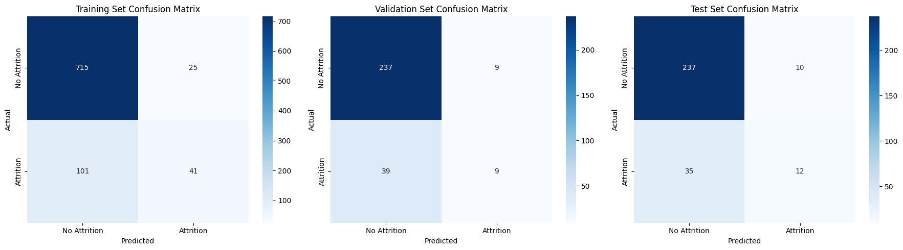
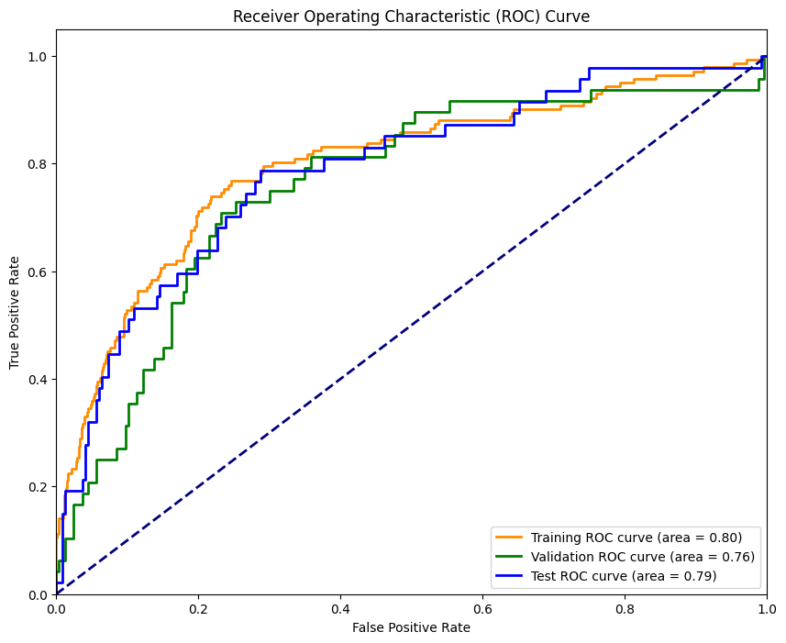
Discriminant
Discriminant Function Coefficients:
Age -0.020548
Education -0.056868
EnvironmentSatisfaction -0.333246
JobLevel -0.491315
JobSatisfaction -0.358649
MonthlyIncome 0.000083
OverTime 1.958809
PercentSalaryHike -0.031335
PerformanceRating 0.390222
StockOptionLevel -0.507520
TotalWorkingYears -0.044358
TrainingTimesLastYear -0.144032
WorkLifeBalance -0.233605
YearsAtCompany 0.011952
YearsInCurrentRole -0.069735
Features Strongly Associated with Increased Likelihood of Attrition (Positive Coefficients): OverTime (1.602)
PerformanceRating (0.656): A higher performance rating is associated with a greater likelihood of attrition.
JobLevel (0.246): A higher job level slightly increases the likelihood of attrition.
Features Strongly Associated with Decreased Likelihood of Attrition (Negative Coefficients): EnvironmentSatisfaction (-0.415)
WorkLifeBalance (-0.406): Similar to environment satisfaction, lower work-life balance decreases attrition (meaning better balance decreases attrition).
Notes:
This suggests to me that people who are doing well may be more likely to leave to find a position that challenges them more

Slide 12

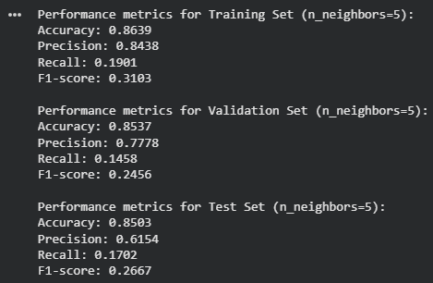
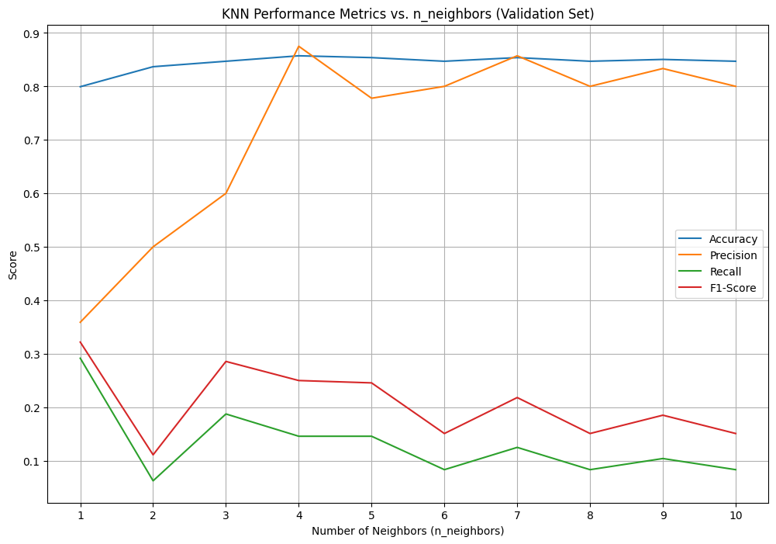
KNN
KNN performance metrics prior to tuning
KNN performance metrics after tuning​
Overfitting addressed, but results still poor
Reduced gap between training, validation, and test performances
Low recall = struggle to identify attrition
Further hyperparameter tuning failed to help
Defaulted KNN best K value to 1
Showed strong signs of overfitting
Unreliable precision with high accuracy
Maintained low recall, F1-score
Notes:
Speaker: George Khramtchenko

Slide 13
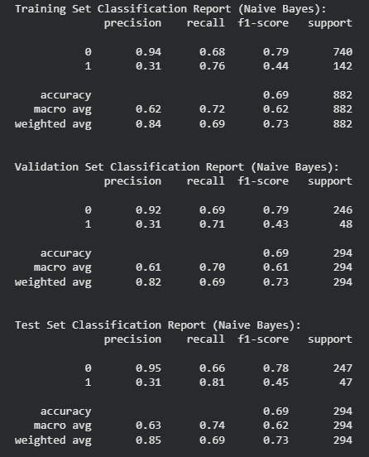
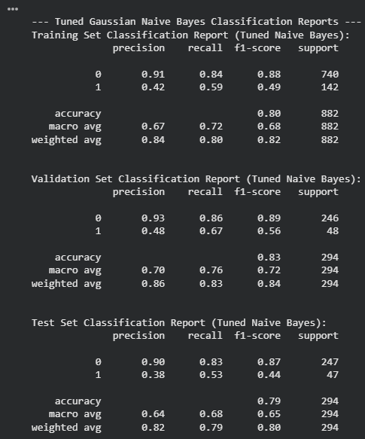
Naïve Bayes
Prone to predicting false positives
Hyperparameter tuning improved precision, accuracy and F-1 score
Recall values felt
Achieved a better balance between false positives and true negatives
NB performance after tuning​
NB performance metrics prior to tuning​
Notes:
Speaker: George Khramtchenko

Slide 14
Logistic Regression Model
Baseline model used to estimate probability of employee attrition.
Included numerical, categorical, and engineered interaction terms.
Key significant predictors included:
  Overtime, Monthly Income, Age, Job Satisfaction, Business Travel, Years at Company.
Tuned logistic model improved AUC and interpretability.
Coefficient signs aligned with business intuition.
Useful for explaining why employees are at risk due to transparent coefficients.
Notes:
Speaker: Amanda Carducci
The logistic regression model allowed us to understand directionally how each variable influences attrition.
Adding interaction terms such as overtime and business travel strengthened the model and improved AUC.
While it is not the highest performing model, logistic regression was crucial for generating business explanations.

Slide 15
Decision Tree
Captures non linear relationships and interaction effect.
The simple tree structure provides intuitive, rule based explanations.
Top splitting variables include:
  Overtime, Monthly Income, Job Satisfaction, and Age.
More flexible than logistic regression but prone to overfitting.
Used tuned parameters to reduce depth and improve generalization.
Notes:
Speaker: Amanda Carducci
The decision tree model helped us visualize how employees split into high and low risk categories based on key attributes.
The fist split, overtime, showed how impactful workload is in driving attrition. Employees with high overtime consistently moved into high risk branches.
To prevent overfitting, we tuned tree depth and minimum samples. This improved accuracy and kept the tree readable.
The decision tree reinforced the patterns seen across other models.

Slide 16
Relevant Business Findings
Attrition is driven by workload, satisfaction, compensation, and tenure.
Top predictors of attrition include:
  Overtime
  Job satisfaction
  Environment satisfaction
  Monthly income
  Total working years/ years at company
  Age
Notes:
Speaker: Amanda Carducci
According to our findings, the key drivers of employee attrition across all models are:
Overtime- which was repeatedly one of the strongest predictors of attrition.
Job Satisfaction and Environment Satisfaction- were strong signals.
Monthly Income- had a strong negative relationship with attrition. Lower income employees were more likely to leave.
Total working years/Years at the Company were important stabilizing factors.
Age- was influential as attrition was highest among younger employees.

Slide 17
Relevant Business Findings Continued
Younger and newer employees with low pay and moderate-low satisfaction show the highest baseline attrition rate.
Employees with 0-3 years tenure were represented among attrition.
Work life balance variables showed visible separation between stayers and leavers.
Early tenure employees need structured onboarding, career pathing, and workload protection.
Notes:
Speaker: Amanda Carducci
Our analysis shows that younger and newer employees with lower salaries and moderate to low satisfaction scores experience the highest baseline attrition rates. This indicates that the earliest stage of th employee lifecycle is the most vulnerable, especially for employees who feel underpaid or unsupported.
Employees with 0-3 years of tenure made up a disproportionately large share of those who left. This early exit pattern suggests that our onboarding, early development, and first role support systems may not be strong enough.
Work life balance indicators which include overtime, job involvement, and work life balance ratings showed a clear separation between employees who stayed and those who left. Employees reporting lower balance or higher overtime were much more likely to churn.
Together, these findings point to a critical need for early tenure retention strategies. Structured onboarding, clear career pathways, and active protection against excessive workload can stabilize this vulnerable population and reduce preventable turnover.

Slide 18
Recommendations
Reduce overtime among high risk roles.
Conduct compensation review for lower income roles.
Implement retention programs for younger, early career employees.
Reevaluate business travel loads for overtime workers.
Notes:
Speaker: George Khramtchenko.

Slide 19
References
Dataset chosen: IBM HR Analytics Employee Attrition dataset from Kaggle.
Includes demographic, compensation, job satisfaction, and performance information.

